Slide 1

Karen Crane, Tourism & Economic Development Manager
City of Merriam

Slide 2

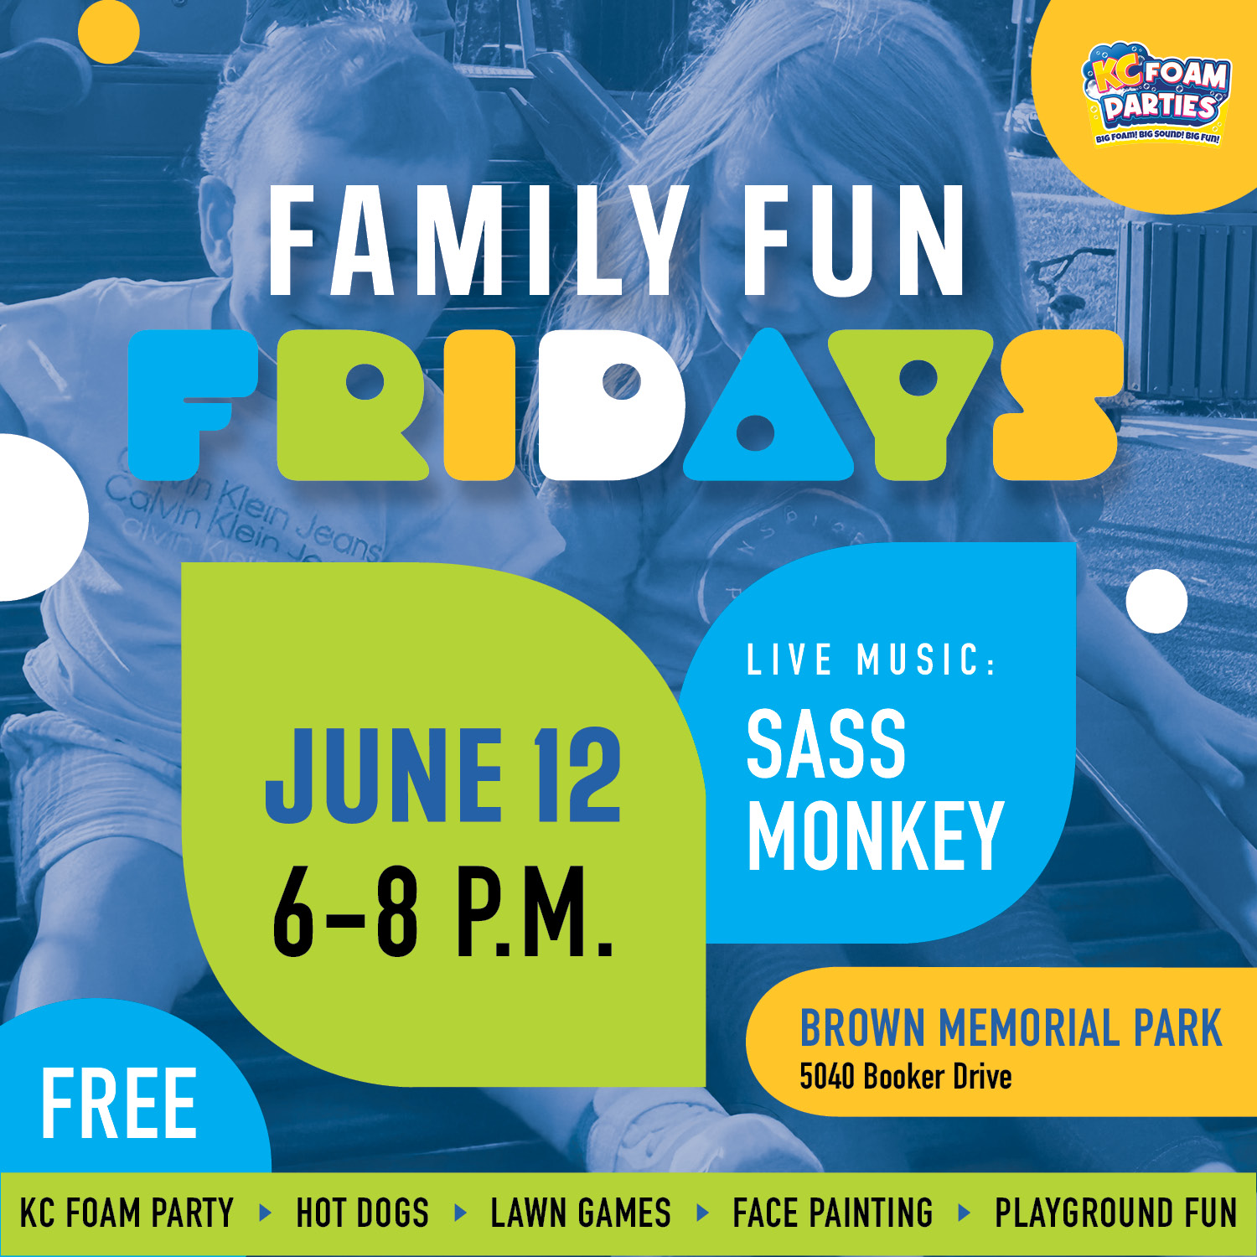

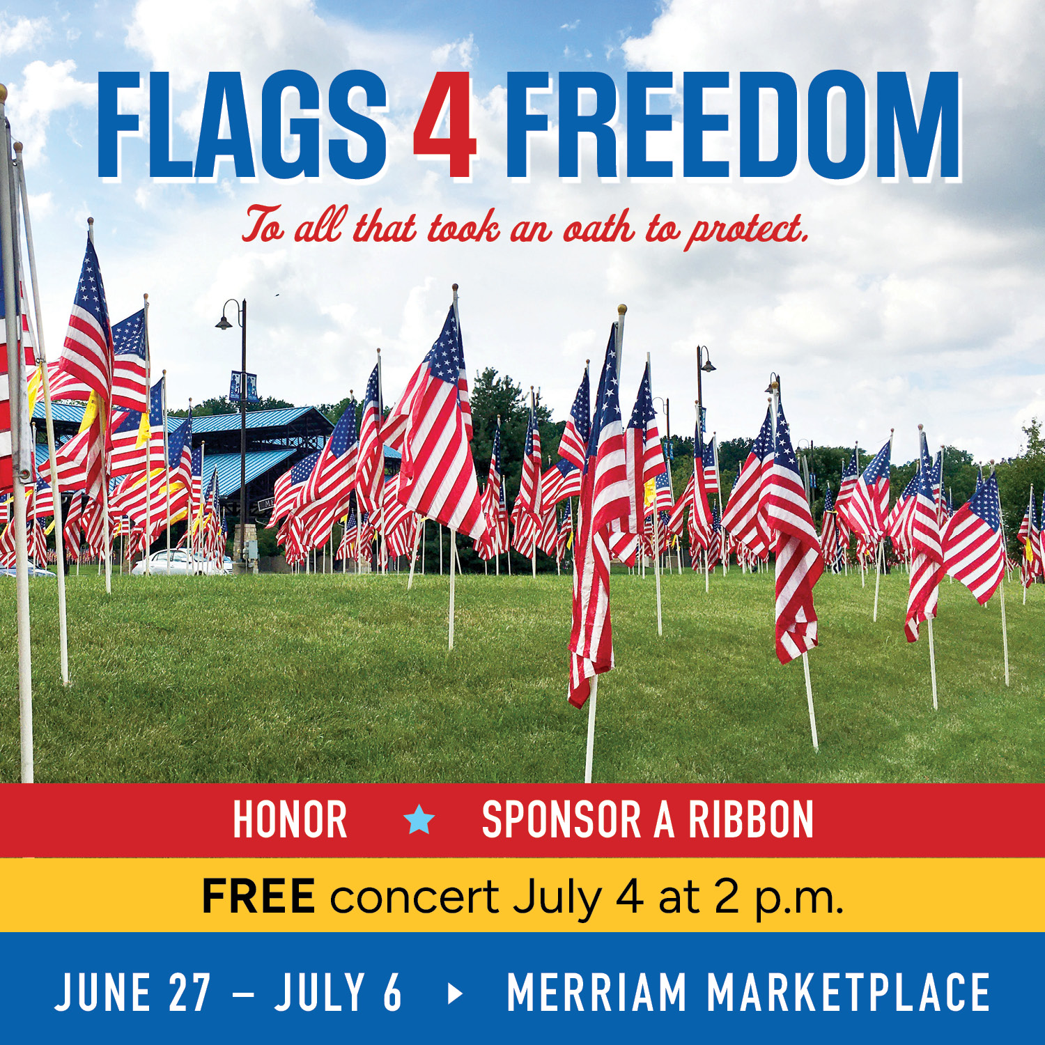
What’s happening here in Merriam?
Events
www.exploremerriam.com/events

Slide 3


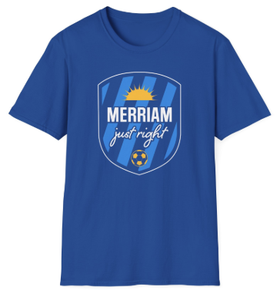

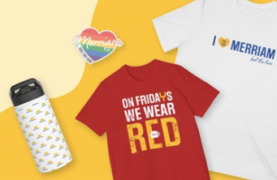
What’s happening here in Merriam?
World Cup Swag
Merch Store
https://city-of-merriam.printify.me/
Order socks, shirts, hats, stickers, and more, all branded with the Merriam sunshine!
New design for World Cup (through December 2026)
Soccer Stress Ball
Lens Cloth
Water Bottle Sticker
Visitor Swag Bags
Available at Merriam hotels upon guest check-in (while supplies last).

Slide 4
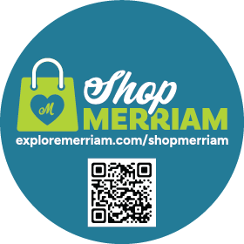
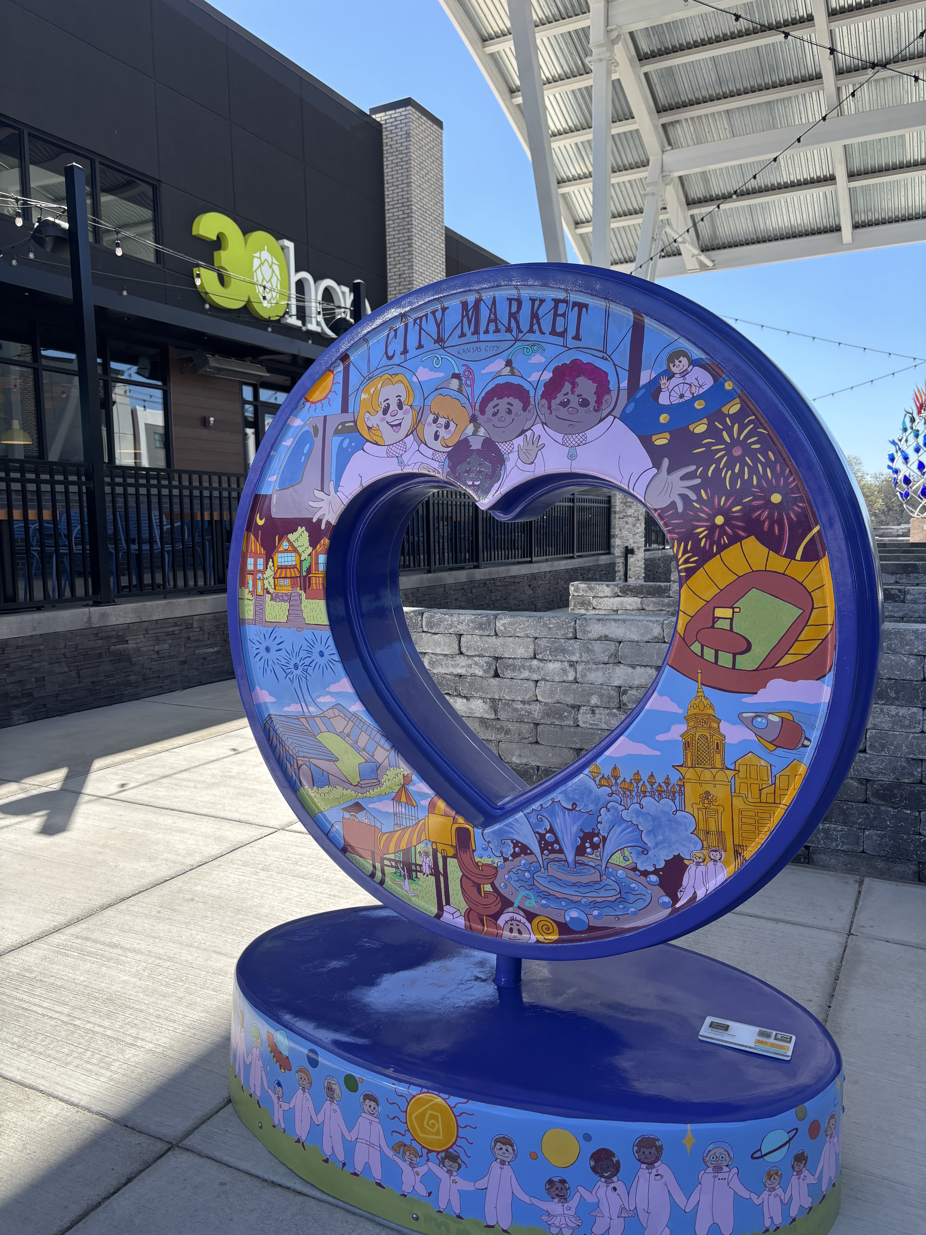

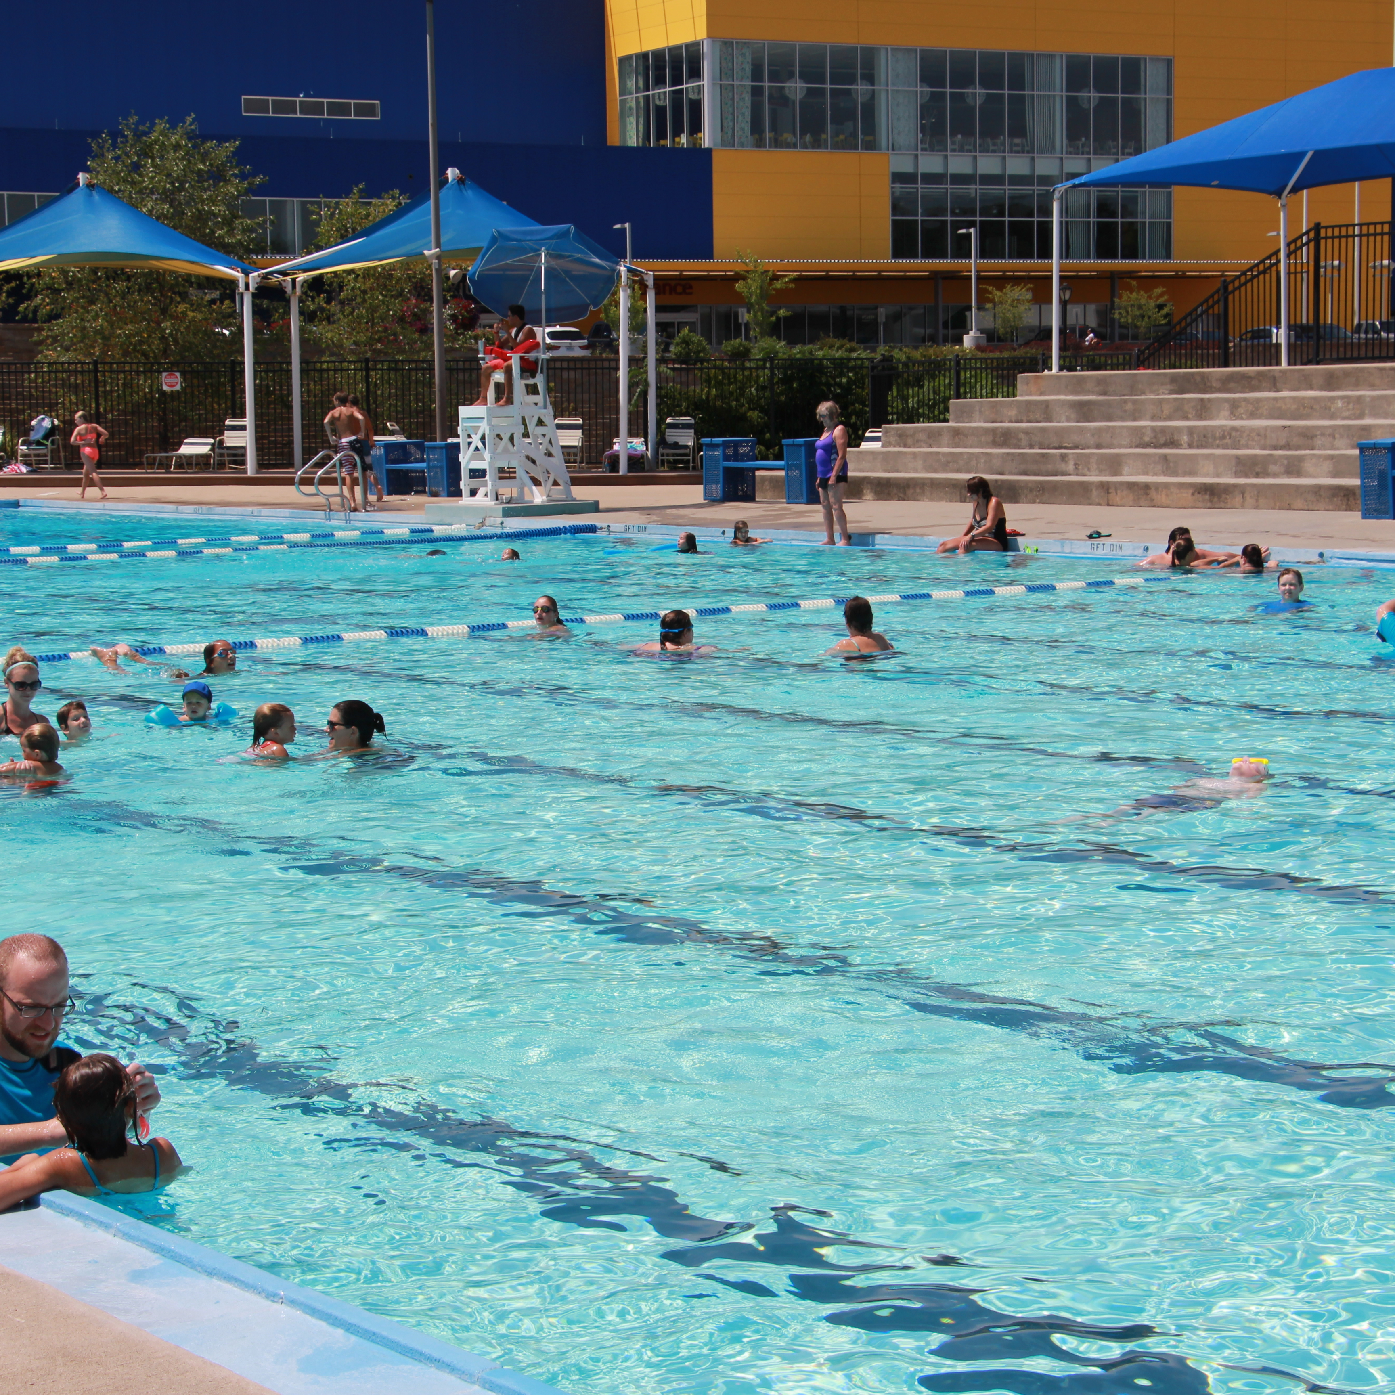
What’s happening here in Merriam?
Promotions
Shop merriam
parade of hearts
social posts
mcc
Must be a licensed Merriam business to participate.
Discount offered to visitors and residents – FREE to participate!
Complete form at www.exploremerriam.com/shopmerriam
The Merriam Community Center invites guests to and enjoy all the amenities including the art gallery, indoor/ outdoor pools, walking track, and fitness center. Rates equal the non-resident daily fee of ($12 adults / $10 children).
If you offer a discount with the Shop Merriam program, we will also add it to the POH portal (pending their approval).
theparadeofhearts.com
From Shop Merriam discounts, to art around town and upcoming nearby events, we have a plan for World Cup social media promotions starting May 1.

Slide 5
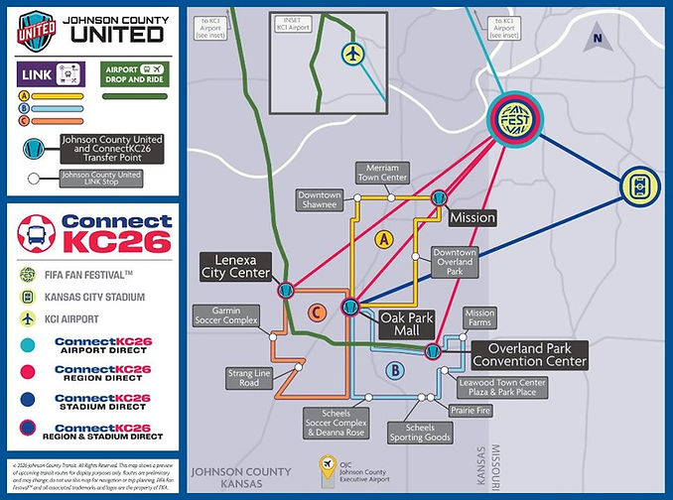
What’s happening here in Merriam?
Transportation
To supplement the efforts of Kansas City’s ConnectKC26, Johnson County is also providing public transportation options through its Johnson County United transit service.
Johnson County United LINK
Includes three routes overlapping at Oak Park Mall and connects the cities of Leawood, Lenexa, Merriam, Mission, Olathe, Overland Park and Shawnee.
Exact routes, stops and hours to be announced.
Learn more: johnsoncountyunited.com/getting-around

Slide 6
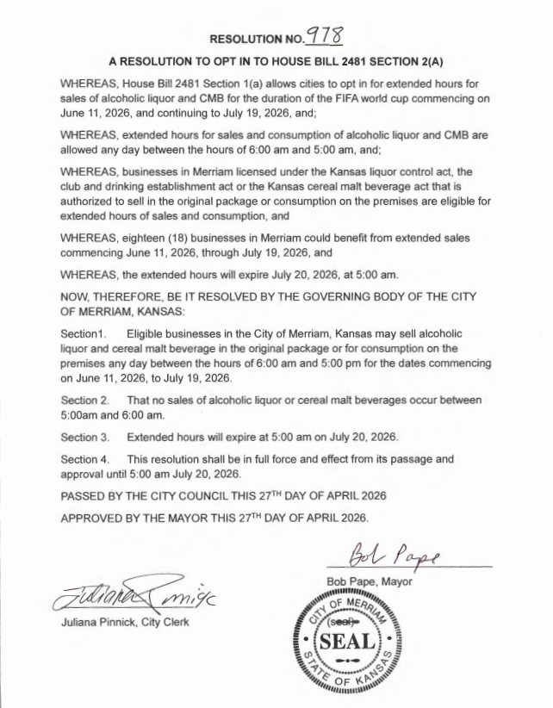
What’s happening here in Merriam?
23-hour liquor/CMB resolution
City of Merriam “opted in” to HB2481 on 4/27/26, but leaves the decision to offer 23-hour sales up to each business
June 11 – July 19 (expires at 5:00 am on July 20)
Allowed between 6:00 am–5:00 am
Licensed businesses under Kansas liquor control act (affects 18 businesses in Merriam)
Eligible businesses can sell alcoholic and cereal malt beverage in original packaging (store) or for consumption on the premises (bar/restaurant) during this time frame

Slide 7
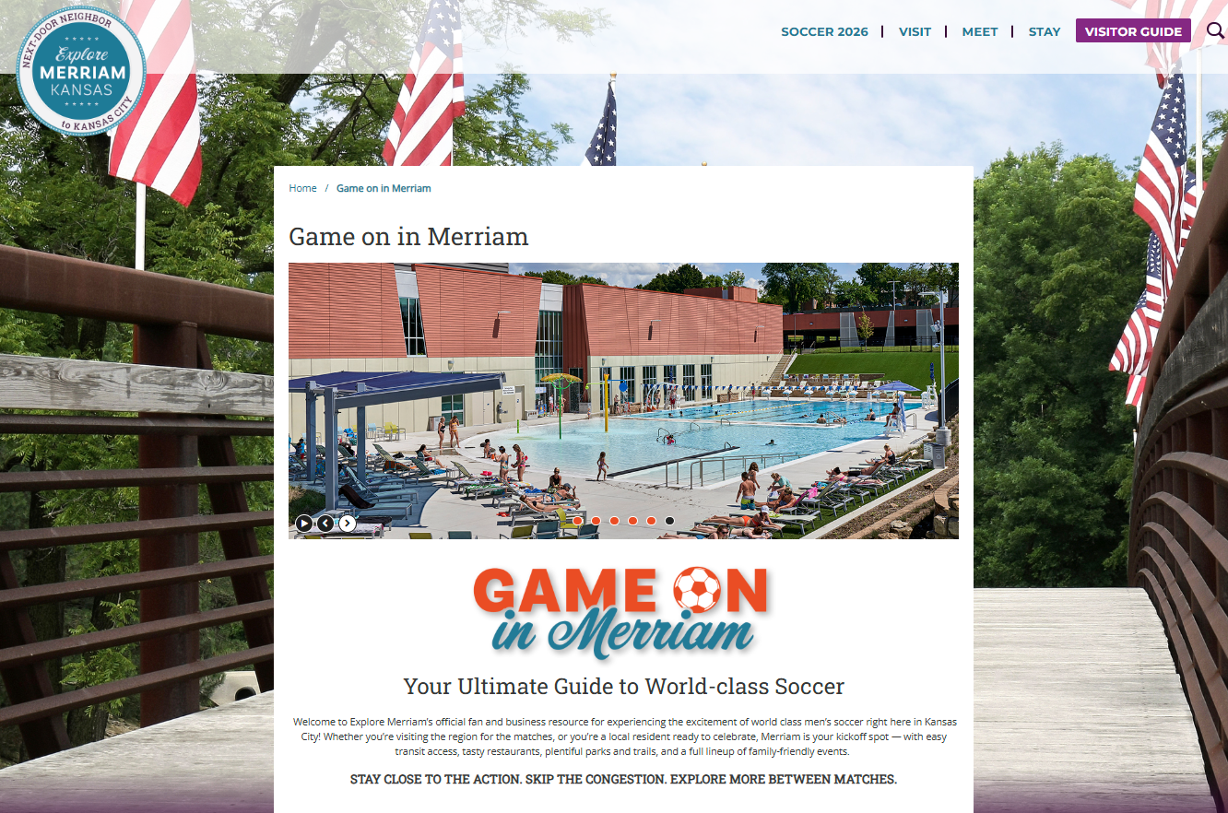
Exploremerriam.com/game-on
Overview
Merriam’s official visitor hub for World Cup
One-stop resource for guests, residents, and businesses
Easy access to lodging, dining, and local amenities

Slide 8
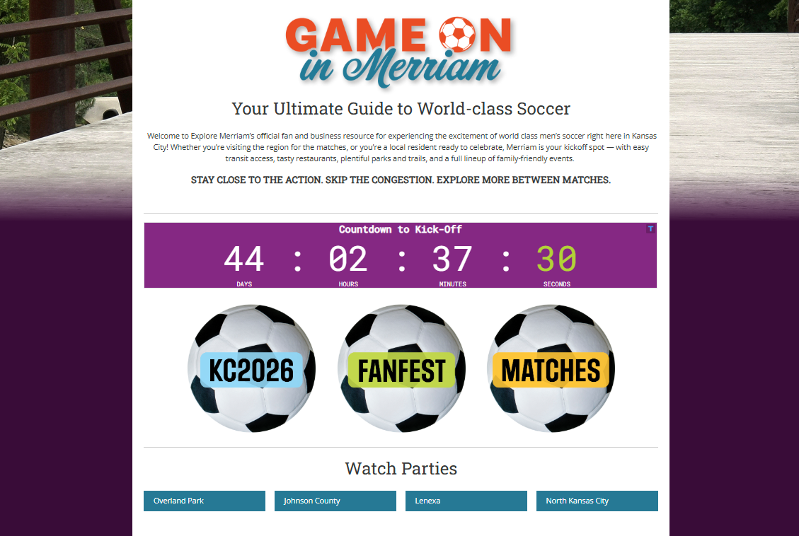
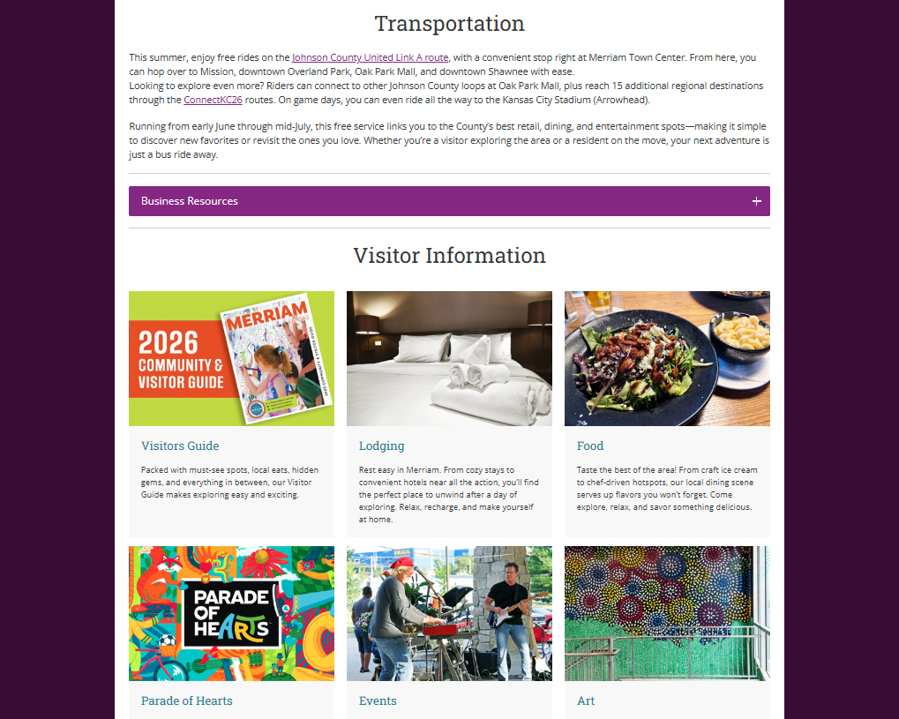
www.exploremerriam.com/game-on

Slide 9


Business resources
https://kansascityfwc26.com/assets/KC2026_Community_Playbook.pdf
https://kansascityfwc26.com/assets/KC2026_GamePlan_Playbook_v1.2.pdf

Slide 10

Tips to evaluate your readiness
YES TO 3 OR MORE?
Consider a special event / promotion.
MUST-DO’s for a successful promotion!
Do you serve visitors, travelers, or locals who will be hosting guests?
Are you located near high-activity zones such as Arrowhead Stadium, the National WWI Museum & Memorial, hotel clusters, entertainment districts, or major attractions?
Is your business district or community organizing special events or festivals that could use your products or services?
If you’re not near a high-activity zone, could you partner with other businesses or create something unique that draws people in?
Can you adapt or scale up your operations –extending hours, boosting staff, or expanding inventory?
Do you offer something distinct – a cultural experience, local flavor, or essential service visitors will need?
Make it easy to find you online (i.e., Google Business, TripAdvisor, Yelp).
Update hours, photos, menus, and descriptions to appeal to visitors.
Train staff to welcome international customers and practice cultural awareness.
Do not use and infringe on FIFA World Cup 2026™ trademarks in your marketing materials.
Decorate with tournament-friendly themes without violating FIFA® trademarks.

Slide 11
Sergeant Kristin Jasinski
Merriam Police Department
City of Merriam

Slide 12
What businesses can expect
Major opportunity for local businesses…
Increased foot traffic, especially:
Before and after matches
Evenings and weekends
During watch parties and large gatherings
Visitors may be:
From out of town or out of the country
Unfamiliar with local laws, layout, and expectations
Expect a high-energy environment—generally positive, but busy

Slide 13
Crowd flow & Customer experience
Think about how customers will move:
Simple steps that help:
Keep entrances and exits clear
Use signage or staff to guide lines
Avoid overcrowding – both for safety and customer comfort
Well managed spaces
In and out of your business
Along sidewalks and shared spaces
Better experience
Fewer issues

Slide 14
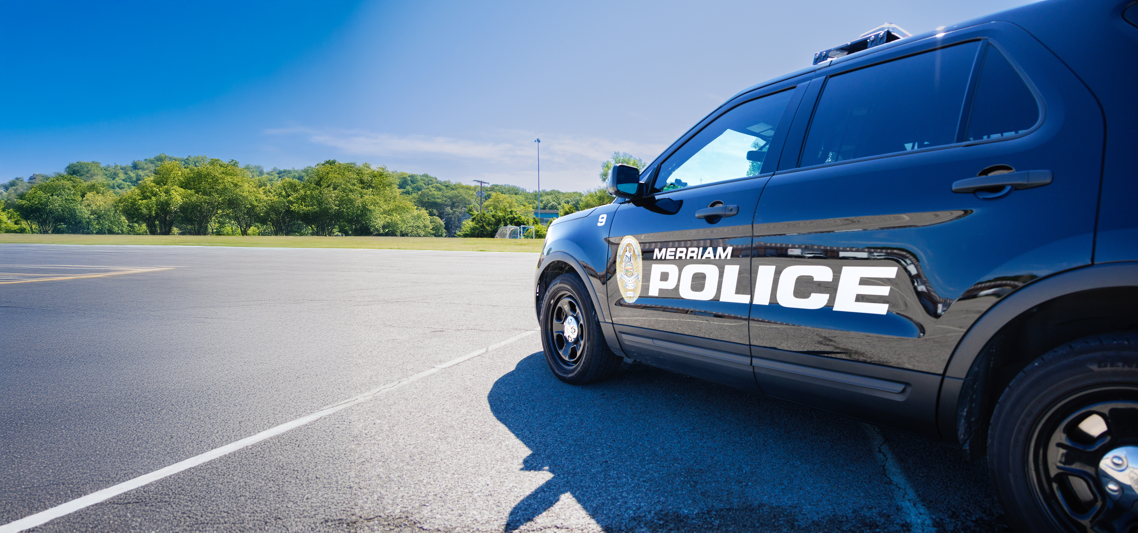
Situational awareness
Without alarm
Encourage staff to stay aware, not anxious
Most visitors are here to enjoy themselves—this is about being prepared, not worried
Things worth noting:
Someone who seems out of place for a long period
Items left unattended
Situations that look like they may escalate
If something doesn’t feel right, it’s okay to check in or call us
MERRIAM POLICE DEPARTMENT
EMERGENCY: 911
NON-EMERGENCY DISPATCH: 913.782.0720

Slide 15
Practical Safety Tips for Businesses
Inside the Business
Money & Transactions
Outside the Business
If You Serve Alcohol
Keep employee-only areas secured
Position staff where they can easily observe entrances
Communicate clearly among staff during busy periods
Limit large amounts of cash on hand
Use secure storage (drop safes if available)
Make sure lighting is working
Keep the area around your entrance clean and visible
Be mindful of how lines or crowds form outside
Pace service and support your staff in making good decisions
It’s okay to slow things down if needed—this helps everyone

Slide 16

When & How to Contact Police
We want to make this simple and approachable:
Call 911 for:
Immediate safety concerns
Medical emergencies
Crimes in progress
Use non-emergency line for:
Suspicious activity
Ongoing issues that aren’t urgent
Helpful info to share when you call:
Location
What’s happening
Description of people involved
Don’t hesitate to call early—we’d rather check something out than have it escalate

Slide 17
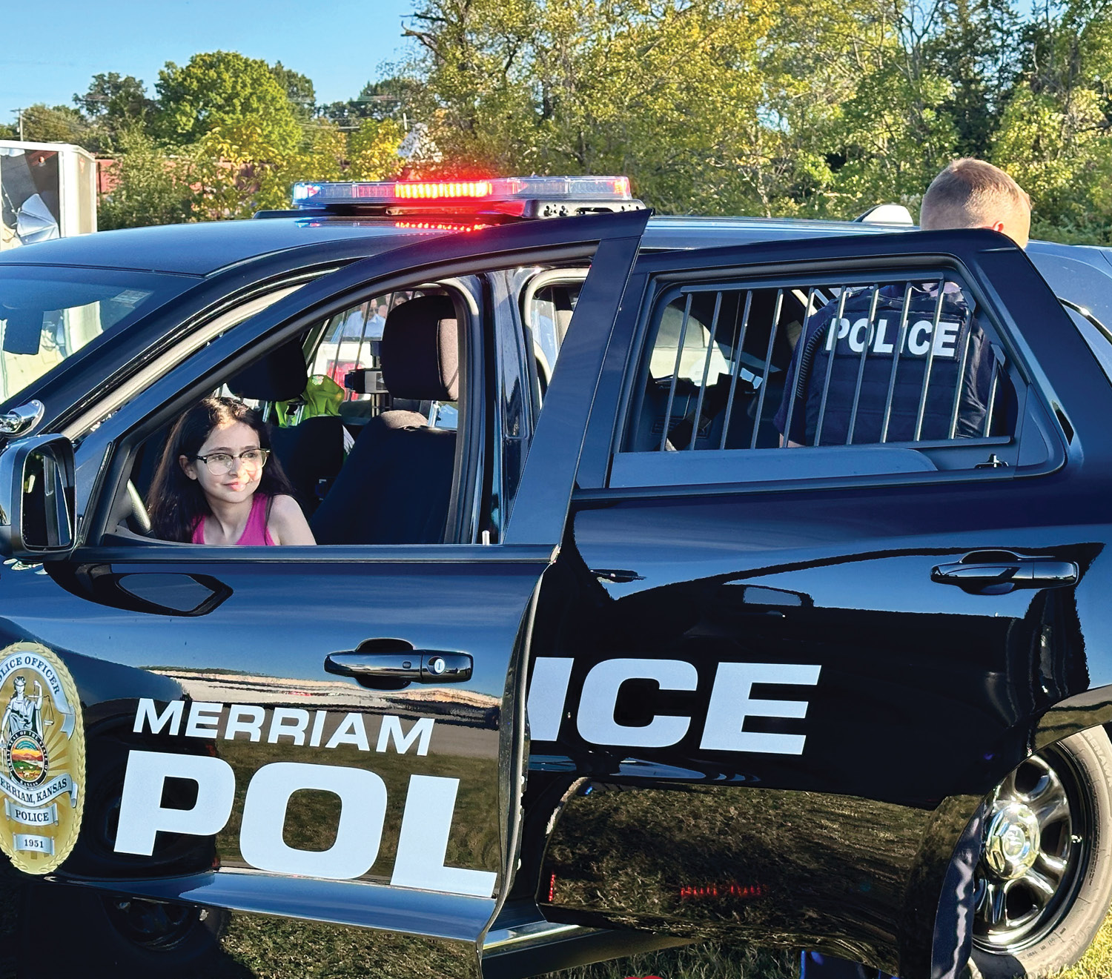
Police presence during world cup
You’ll see increased officer presence in key areas. This is meant to:
Support businesses
Provide quick response if needed
Help with traffic and crowd flow
Officers are there as a resource – feel free to approach them!

Slide 18
Emergency Readiness (Simple & Practical)
Communication & Staying Connected
You don’t need a complex plan—just basics:
Make sure staff know:
Where exits are
Who calls 911
Where to go if you need to clear the building
A quick 2-minute staff conversation before a busy shift goes a long way.
We’ll share updates through:
City channels
Police department social media
We encourage businesses to:
Stay plugged into those updates
Reach out with concerns or questions before and during the event

Slide 19
Let’s work together
This is a chance to showcase our community.
Safe, welcoming environments benefit:
Your business
Your employees
Our residents, other businesses, and visitors
We’re here to partner with you—not just respond to problems!

Slide 20
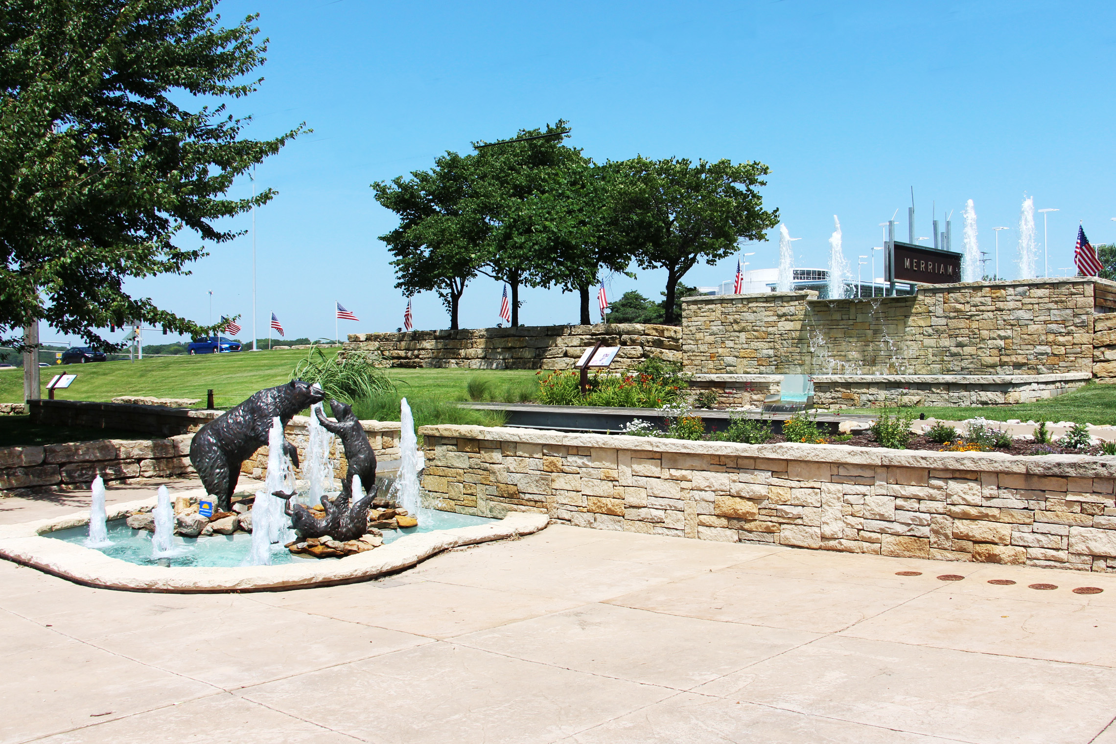
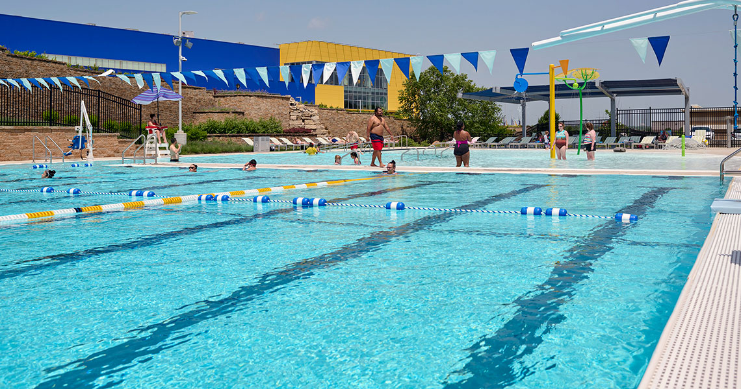
Helpful contacts
Merriam police dept.
911
Non-emergency dispatch
913.782.0720
Merriam community center
913.322.5550
6040 SLATER ST.
Daily passes available at non-resident rate
MERRIAM VISITORS BUREAU
kcrane@merriam.org
913.322.5534
Follow us:
@ExploreMerriam
@MerriamPolice
@MerriamCommunityCenter

Slide 21
Thank you!

